Slide 1
Welcome Judges!
2024 Contest Judge Orientation
Notes:
Note to Coordinators: Feel free to edit this text (and any other slides)! All NHD logos are “fixed” and cannot be moved, but if you see an OHD logo it’s a placeholder for your to put your organization or affiliate logo once we’ve finalized the PPT and you make a copy.

Slide 2
Thank You!
Notes:
(30 sec.)
Before we begin, we want to take this moment to THANK YOU for signing up to be a judge this year. As you know, this is not your typical contest year. Thank you for rising to the occasion to not only judge at our contests, but to do it virtually!

Slide 3
Webinar Agenda
Today We Will Review:
The Contest Theme, Rules, and Judging Criteria
The Judge Toolkit
Next Steps & Judging Deadlines

Slide 4
The Contest Theme, Rules & Criteria!

Slide 5
2024 Contest Theme
Notes:
1 min.
To provide a focus for student research and topic selection, the NHD contest has an annual theme.
It is big and broad on purpose to give students a lot of leeway.
Students may choose any topic.
There is NO rule that prohibits topics more recent than x number of years.
Their task is to justify how their topic fits the annual theme and demonstrates historical significance. It is difficult to demonstrate historical perspective for very recent topics that are still unfolding. If historians have not written about it and provided historical perspective, it’s likely not a good idea for an NHD project.
Coordinators:
Consider saying something about the myth that topics must be x number of years old, which is NOT true. Explain that students may truly choose any topic, but they must prove that it fits the theme and is significant in history. However, this significance does not have to have a direct connection “to present day”.
It is not the judges job to decide whether to project fits the theme, but whether the student convincingly connected their topic to the theme through their work.
Consider explaining here that they will likely see topics that they personally like, dislike, are really excited about, and are tired of seeing. NONE of those feelings should get in the way of their evaluation of the project. They MUST diligently check themselves for bias and consciously work to overcome it.

Slide 6
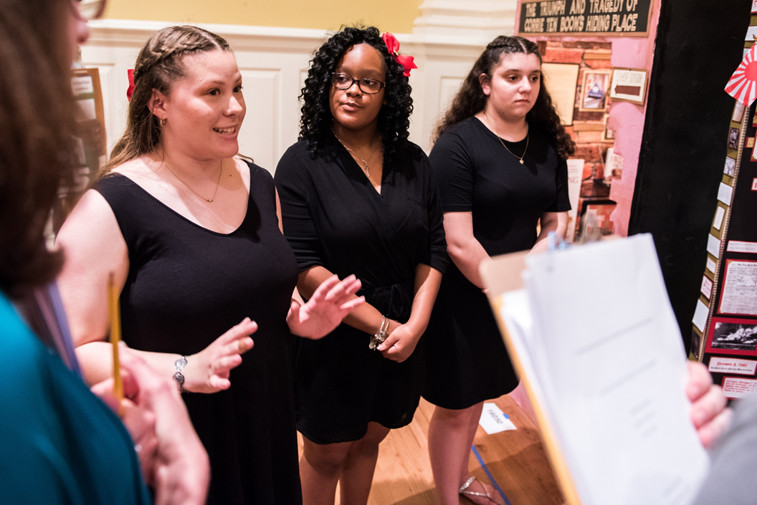
A Judge’s Role
Goal
Encourage students to keep learning by providing constructive feedback on Evaluation Sheets!
Accomplish this by
Be aware of bias!
Provide constructive comments!
Work as a team to achieve consensus on both:
Rank Sheets
Evaluation Sheets
Notes:
Be the Encourager, Inquirer, Novelists, and Team Player:
The Encourager - Gets them excited about the experience and the conversation
The Inquirer - Good and open ended questions; non-personal
The Novelist - Write the best comments in depth
The Team Player - Wants every judge to have a role and contribute
Be Aware of Bias:
Everyone has things they are more interested in, and know more about. Make sure your show an equal amount of interest in each project, and take the students seriously.
Here are some ways bias can show up in NHD:
Non-traditional history topics – ex. Pop music, sports, fashion
Oral sources – Cultural traditions and stories handed down over generations
Resonant topics – those you absolutely love or feel passionate about one way or the other. Consider whether a topic triggers you.
Political – A topic that touches on the realm of politics – either directly or indirectly; perhaps there is a strong connection to current events
Cultural differences – ex. Students from a culture other than yours who may not make eye contact or shake hands.
Provide constructive comments:
At the end of the day, you want the students to understand why you evaluated their work the way you did. The evaluation form is your tool.
Students will review your evaluations very carefully as they try to understand why you did or did not advance their entry. Help them by checking boxes in the same range and writing clear, unambiguous and constructive comments.
Work as a Team:
Goal is to achieve consensus
The role of the captain is to collect paperwork and ensure it gets to the NHD staff – they are not the boss or ruler of the group.

Slide 7
Contest Rules
Visit nhd.org/how-enter-contest for a complete set of the rules!
Notes:
Approx. 1 min
Brief reminder that there is a NEW contest rule book! Emphasize the importance of paying attention to this presentation - even if you are a seasoned judge.

Slide 8
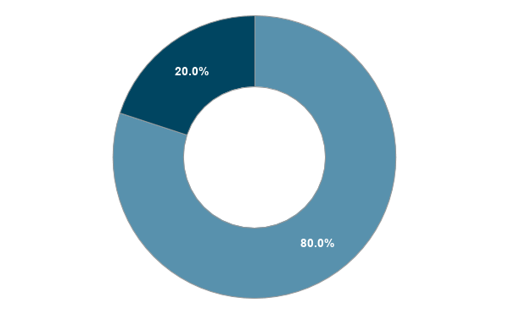
Evaluation Criteria
Historical Quality (80%)
Historical Argument
Theme
Wide Research
Primary Sources
Historical Context
Multiple Perspectives
Historical Accuracy
Significance in History
Clarity of Presentation (20%)
Audio/Visual (Documentary)
Written Material/Visual (Exhibit, Website)
Written Material (Paper)
Performance (Performance)
Technical (All)
Student Voice (All)
Notes:
2-3 min.
•The MOST important is historical quality, and relation to the theme.
•Do NOT get hung up on clarity of presentation errors that can be fixed. Typos, glue smears, improper formatting, etc. can all be corrected before the next level. We’ll talk more about this shortly.
This slide will be designed to display in sections. Once the PPT is finalized, hit the spacebar or arrow keys to display all of the information.

Slide 9
Infraction vs. Disqualification
 | Minor Infraction | Major Infraction | Disqualification
Definition | A violation that does not provide a competitive advantage | Exceeding any of the equalizers(time, size, words), thus creating a competitive advantage by being able to provide more information | The ONLY grounds for this are: entering a project in multiple contests or categories within a contest year; reusing an entry (group or indiv.) or research from a previous year; plagiarism; tampering with another entry.
Example | School name on process paper, exceeding word count by 10 words, etc. | Exceeding words by 10+, size by 1 inch+, time by more than 5-10 seconds.
Procedure | Note these in your comments. These violations should not prevent an entry from advancing. Consider them only to break a tie between two entries that are otherwise equal. | Note these in your comments. These entries should NOT advance. If they truly are the best, please consult with NHD staff. | Please do not act on your own. Bring this concern immediately to NHD staff, who will decide if the entry should be removed from competition.
Notes:
Judges this is VERY IMPORTANT! - Please do not use the word “disqualification” in reference to anything other than the four violations that lead to disqualification. This is confusing to students, teachers and parents. Disqualified means removal from the competition.
Consider mentioning the handout version of this to accompany this slide.
Stress the procedural part of this process. Judges must bring concerns to your attention. As coordinator, YOU have the responsibility of verifying the accuracy of these accusations and notifying the teacher and students of the decision.
Consider telling judges flat-out to not use the word “Disqualification” in interviews with students or written comments. Even if you suspect a disqualifiable offences, let the Coordinator handle it.
Feel free to substitute “NHD staff” with your name.

Slide 10
Evaluation Forms!

Slide 11
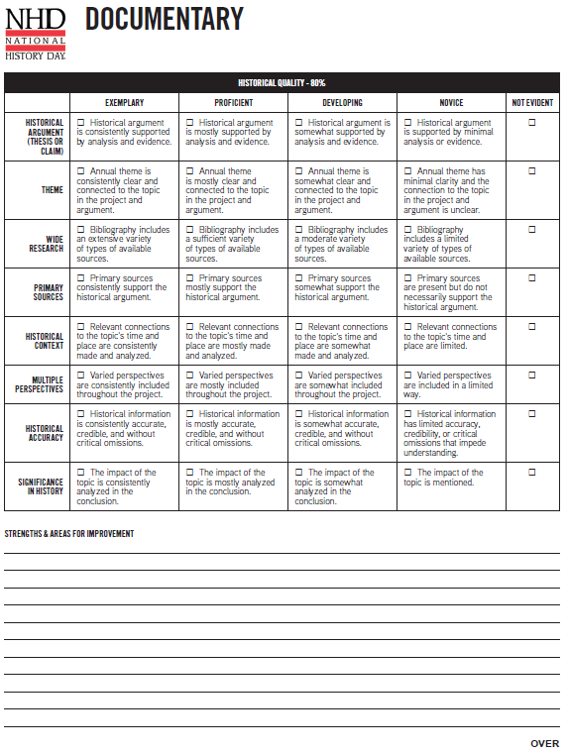
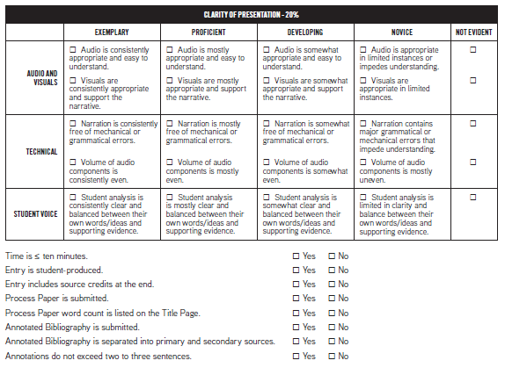
NEW Evaluations: Key Criteria
Side 1:
Entry Information
Historical Quality Criteria
Comment Space
Side 2:
Clarity of Presentation Criteria
Rules Compliance Checkboxes
Notes:
1 min.
Coordinators: Ask judges to look at one of their evaluation forms as you orient them.
On Side 1:
Note the entry info at the top – always double check that you are marking the correct form for each entry.
Historical Quality Criteria –
Not Evident – Check this when the criteria is impossible to evaluate because it is missing from the project.
Superior, Excellent, Good, Fair – For each of these, become familiar with the specific descriptor.
Read from right to left
Each level builds on the previous one
Evaluate by marking the appropriate box, not based on the words “Superior, excellent, etc.”
Check the box(es) in each row as you evaluate each entry. For criteria with more than one descriptor, it is okay to check one box in a particular column and the other box in another column.
Comment Space – Use this space to elaborate on what you’ve checked above and provide constructive feedback and suggestions. It’s okay to spill over to the back.
Again, please remember to evaluate the project based on the criteria and not the words of “superior …”
On Side 2:
Clarity of Presentation Criteria – Ditto with the concepts from side 1.
Rules Compliance – These are yes/no, meaning is the rule followed or not. Use the comment space to explain, as needed.
Comment Space – Use this space to elaborate on what you’ve checked on this side – or general comments to help the student(s) understand why you are evaluating the entry as you are.

Slide 12
NEW Evaluations: Column Headers
Example: Key characteristics for annual theme are clear and connected.
When possible, descriptors use a consistent response scale
Consistently
Mostly
Somewhat/Sometimes
Limited (often rephrased to maintain positivity)
Select the descriptor that is most true based on the project you are viewing, not how the project compares to others.
Revised 2021-22
Exemplary
Proficient
Developing
Novice
Not Evident
Notes:
Judges were still relying too heavily on the column headers, instead of the descriptors, to evaluate projects. To break with the old form, and remove value-laden language, we have revised the column headers to the following:
[Go to next slide to explain how Judges should pick the right descriptor.]

Slide 13
Picking the Right Descriptor
Descriptors are not exact matches comparing different things. For example, is this cherry or apple pie?
Apple
Cherry
Pumpkin
Lemon
Descriptors create a continuum comparing the same thing and trying to determine how much of it there is in the project. How much apple pie is in the pan?
Consistently
Mostly
Somewhat
Minimal/
Limited
Notes:
Notice that the words that change between the descriptors for a specific criteria are the continuum words – consistently, mostly, etc.

Slide 14
Historical Argument (Thesis or Claim)
Historical Argument examines the central point or focus of the project and is crafted based on presented historical evidence.
Projects must make a meaningful connection to the theme, incorporate it into the project, and show why the topic is significant in history.
Exemplary Proficient Developing Novice Not Evident
Notes:
HISTORICAL ARGUMENT includes multiple check boxes:
Check the boxes that represent the evidence in the project
Checks do not need to be in the same column
Using the rubric, to move beyond the “Fair” box, the project needs to show evidence throughout to prove their historical argument.
If you only get dates and names, that would not go under “Superior”

Slide 15
Annual Theme
Theme refers to the “big idea” that unifies all NHD projects for a contest year. Each entry must connect to the annual theme.
Exemplary Proficient Developing Novice Not Evident
Notes:
ANNUAL THEME
Key things to consider:
Goes beyond just using the words
Connecting to the fundamental ideas
Connection must be evident
Descriptors: What does it mean to be “clear and connected to the topic in the project and argument”? Then, what does it mean for the student to do so on the scale between consistently and minimal?
Not evident = This element is not present in the project and thus cannot be evaluated. An entry with a NOT EVIDENT criterion should NOT advance.

Slide 16
Wide Research
Wide research refers to the variety of types of available sources (books, articles, credible websites, diaries, photographs, newspaper articles, letters, etc.) that are used in the research.
Exemplary Proficient Developing Novice Not Evident
Notes:
WIDE RESEARCH
Let’s look at what this means and what students are told they must do.
Descriptors:
What does it mean to have a “variety of types of available sources”? Then, what does it mean for the student to do so on the scale between extensive and limited?
Not evident = This element is not present in the project and thus cannot be evaluated. An entry with a NOT EVIDENT criterion should NOT advance.
Sources found on the Internet are perfectly fine IF they are credible.
The Internet is not a type of source. It’s more akin to a library.
Types = books, journals, diaries, letters, photos, videos, interviews (primary preferred), audio, etc.
Secondary-source interviews are discouraged in the rule book. Students may still do them. For NHD, it’s better to include primary-source interviews and only consult secondary sources (e.g., historians) if they have a nuanced question about the person’s research, NOT to ask fact-based questions.
Consider that some topics will lend themselves to a wider variety of types of sources than others. For example: oral histories, photos, and newspapers simply do not exist for ancient history topics. For those, students might rely more heavily on art.
Some sources in the bib will be unavailable to judges because students were given access to the subscription at the library. This is great! Do not penalize them because you can’t check it.
Remember that you are evaluating the work of student researchers, who this year may be relying more heavily on sources they can find on the internet. They cannot be expected to access collections available only by traveling a great distance.

Slide 17
Primary Sources
Connected to an event by time or participation.
They may include, but are not limited to: eyewitness accounts, letters, speeches, diaries, images, artifacts newspaper articles, oral history interviews with people from the time, or oral traditions.
Exemplary Proficient Developing Novice Not Evident
Notes:
PRIMARY SOURCES
Let’s look at what this means and what students are told they must do.
Descriptors:
What does it mean for primary sources to “support the historical argument”? Then, what does it mean for the student to do so on the scale between consistently and not necessarily? The question is HOW are they using the primary sources.
Not evident = This element is not present in the project and thus cannot be evaluated. An entry with a NOT EVIDENT criterion should NOT advance.
Students sometimes confuse primary with secondary. Look to their annotations for how they used the sources. Sometimes students will include rationale for classifying a source as primary or secondary.
Students should be using these to develop their topic. This is the evidence that should support their argument.
Focus on quality over quantity – not all topics lend themselves to the same amount of sources. For example – ancient vs. 20th century US history.

Slide 18
Historical Context
Historical context is the larger setting in which a topic took place.
May include relevant economic, social, intellectual, religious, cultural, or political conditions of the place and time.
Exemplary Proficient Developing Novice Not Evident
Notes:
HISTORICAL CONTEXT
Let’s look at what this means and what students are told they must do.
Descriptors:
What does it mean to “make and analyze relevant connections to the topic’s time and place”? Then, what does it mean for the student to do so on the scale between consistently and limited?
Not evident = This element is not present in the project and thus cannot be evaluated. An entry with a NOT EVIDENT criterion should NOT advance.
A student’s topic didn’t just appear out of nowhere.
Look for a framing of the topic in the context of before and after.
How does the historical context connect to the topic?
This is all about stage setting – does the student see how the topic fits into its historical surroundings?
Are they pointing out what is relevant to the topic’s time and place vs. what is simply interesting to them?

Slide 19
Multiple Perspectives
A perspective is one point of view, one person’s experience, or side of the story.
Multiple perspectives are present when a topic is viewed from more than one point of view, primarily those with different opinions.
Exemplary Proficient Developing Novice Not Evident
Notes:
MULTIPLE PERSPECTIVES
Let’s look at what this means and what students are told they must do.
Descriptors:
What does it mean to include “varied perspectives throughout the project”? Then, what does it mean for the student to do so on the scale between consistently and limited?
Not evident = This element is not present in the project and thus cannot be evaluated. An entry with a NOT EVIDENT criterion should NOT advance.
This is all about the student developing a clear understanding of how the topic was viewed differently by different participants or observers.
To be clear, we’re looking for differing points of view, not necessarily several sources that agree 100% with each other.
Multiple Perspectives - The students should examine and show more than one side of the story. To do that, look for the use of primary and secondary sources created by people with different viewpoints.
Example: When studying a law, students should look at people who supported the law as well as those who opposed it. Try to understand why both sides believed the way they did.
Reality of research during COVID - more online resources than normal. Use of a wide variety of both primary and secondary sources will make the student's entry stronger. The number of sources is not as important as their quality.

Slide 20
Historical Accuracy
For NHD, historical accuracy includes three parts: Accurate, credible, and without critical omissions.
Exemplary Proficient Developing Novice Not Evident
Notes:
HISTORICAL ACCURACY
Let’s look at what this means and what students are told they must do.
Remember, you are not supposed to be content experts. Rather consider the following:
Accurate: Free from mistakes in historical information
Credible: The information is reasonable to believe.
Without Critical Omissions: Includes all information needed for a complete understanding
Descriptors:
What does it mean for historical information to be “accurate, credible, and without critical omissions”? Then, what does it mean for the student to do so on the scale between consistently and limited?
Not evident = This element is not present in the project and thus cannot be evaluated. An entry with a NOT EVIDENT criterion should NOT advance.

Slide 21
Significance in History
The impact or consequences of a topic, both in the short term and the long term. Look for:
Impact: Look for short and long-term impact (or legacy).
So what? How did the topic change history?
Global vs. Local: Both are okay - success of a project does not depend on the scale of impact.
Exemplary Proficient Developing Novice Not Evident
Notes:
SIGNIFICANCE IN HISTORY
Let’s look at what this means and what students are told they must do.
Descriptors:
What does it mean for the impact of the topic to be “analyzed in the conclusion”? Then, what does it mean for the student to do so on the scale between consistently and mentioned?
Not evident = This element is not present in the project and thus cannot be evaluated. An entry with a NOT EVIDENT criterion should NOT advance.
How is this different from historical context?
This is all about impact – So what? Why is this topic memorable or relevant? The legacy - does the student wrap it up?
Context is about causes and stage-setting.

Slide 22
Student Voice
Student voice refers to the ideas and analysis of the student.
The student's argument and supporting analysis must be clear in their project.
How does a student make sure that ideas, analysis, argument, and conclusions are original and persuasive?
Is there a connection to the theme?
Exemplary Proficient Developing Novice Not Evident
Notes:
It’s important to note that this moved to the “Clarity of Presentation - 20%” Criteria.
STUDENT VOICE
Let’s look at what this means and what students are told they must do.
Descriptors:
What does it mean for student analysis to be “clear and balanced between their own words/ideas and supporting evidence”? Then, what does it mean for the student to do so on the scale between consistently and limited?
Not evident = This element is not present in the project and thus cannot be evaluated. An entry with a NOT EVIDENT criterion should NOT advance.
Students sometimes tend to rely on their sources to speak for them. For example, they’ll cover an exhibit or a website in quotes, perhaps as a way to get around the word limit. But, by doing that, we don’t know what the students think or what conclusions they have drawn. In particular, students tend to use quotes from secondary sources to explain the conclusion.
This gives us a way to address this problem and encourage students to take greater ownership of their projects.
A reliance on the ideas of others shows up in the annotated bibliography but can also be seen in the project itself. Consider the images and audio used in a documentary or the words used in a performance. Do you hear or see the student’s analysis or is that coming from quotes or secondary interviews?
In exhibits, websites, and papers, look at the use of quotes. Who’s doing the analytical work?

Slide 23
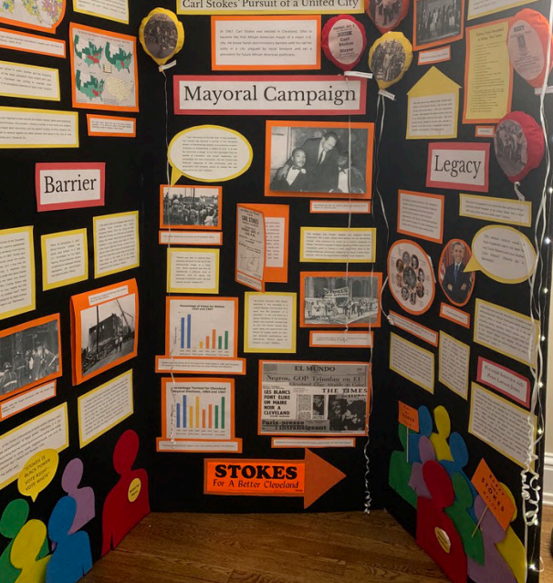
How might a student’s voice be lost?
Documentary
Long video clips
Paper
Long block quotes
Performance
Narrator or “professor” character reading from a secondary or primary source
Exhibit & Website
Overuse of quoted material from primary and secondary sources without analysis from students.
Notes:
Now, this is not the end all be all. These are potential examples of how student voice may be missing. The key here is to see the students analyze their sources and materials.
Supporting evidence, such as quoted material from primary or secondary sources, should support and enhance, not overwhelm the student's work.
If you see any of these, include them in your judge comments and help the students understand the importance of analyzing quoted materials, etc.

Slide 24
The Judging Process
1
2
3
Read
Process Paper
Read Bibliography
View the Project
Notes:
1 min.
This is a great approach to interacting with every entry and student/ group of students.
It IS okay to make notes about the entries as you go. Just be sure put those in the “Personal Notes” section on the evaluation forms. Alternatively, use the blank sheets of paper or word doc, being careful to associate the entry number so you can keep track.
Remember, you should be evaluating each project individually. At this stage, judges should NOT be making comparisons between projects (that comes in the ranking).

Slide 25
Writing Comments
Explain your markings through constructive and positive comments.
Phrase clearly.
Explain how they can improve.
Positive comment
Constructive
comments
Positive comment
Notes:
So let’s talk about how you write a good comments for students!
Try to include at least 2 or 3 in-depth comments - you have to write 500 characters minimum.
Expect quality, but remember that you are evaluating the work of young students who are just beginning to learn historical research, project development and presentation techniques.
The very best, the very worst and every entry in between deserve ample comments. The students have worked literally hundreds of hours researching their topics and creating their projects. Make it worth it to them! This is a little different in the virtual environment.
Remember – the students have taken on a lot during this pandemic. Please make this a positive experience for them, including during and after the contest.

Slide 26
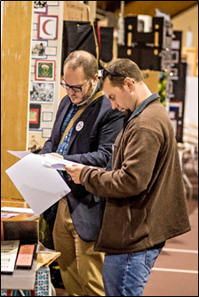
Evaluation Tools
Title Page
Process Paper (ALL Categories, incl. Paper)
Annotated Bibliography
Title Name Junior Division Paper Paper: 2,406 words Process Paper: 410 words | Title Names Senior Division Group Exhibit Exhibit: 495 words Process Paper: 485 words | Title Name Junior Division Individual Performance Process Paper: 435 words | Title Names Senior Division Group Documentary Process Paper: 415 words
Notes:
Title Page – should include the following: title of entry, student names, contest division (youth, junior or senior) and category entered (individual/group paper, exhibit, documentary, performance, or website), and applicable word count(s). See the rule book for more information.
Mention that the websites have a “homepage” and this is where you will see this information
Process Paper – 500 words or fewer discussing how student conducted their research and created the entry. It should include four sections:
How did you choose your topic and how does it relate to the annual theme;
How did you conduct your research
How did you create your project
What is your historical argument
In what ways is your topic significant in history
Grammar and spelling is important, but more important is that they have addressed each of the five questions posed to them.
Annotated Bibliography – list of primary and secondary sources used in the development of the student’s entry. Each source annotation should be no longer than 3 sentences and must include the following:
Citations should either be in Chicago or MLA
Evaluate bibliographies based on the strength of their sources, the breadth of their research, appropriateness to the topic, and a student's ability to investigate the sources.
Thicker does not equate to better. Quality matters more than quantity. Depending on the topic, source availability varies.
Does it show both primary and secondary sources?
Annotated bibliographies are directly related to the criteria of historical quality - they show the extent and value of a student’s sources. They are critical and must be reviewed.

Slide 27
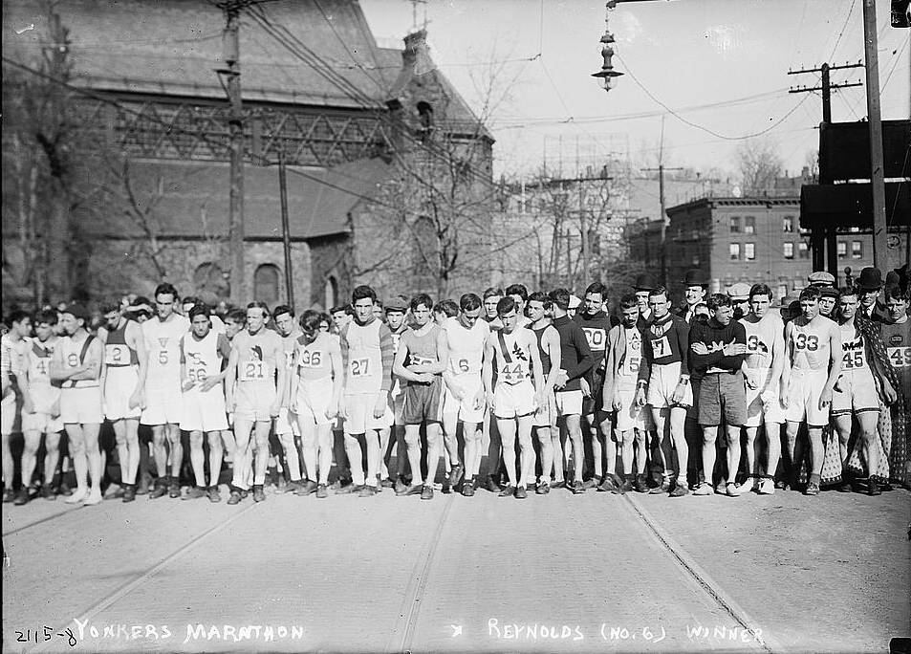
Evaluation vs. Ranking
Different but related tasks
Evaluating assesses how well an entry did against the criteria. It is what you do when you select descriptors for each criterion.
Example: A runner’s time in a race is true no matter the strength of their competition.
Ranking determines the relationship of the entries against each other. It is what you do to pick top entries.
Example: A runner’s rank in the race depends on how well all the runners do.
K. Switzer, 1967. Boston Herald
Yonkers Marathon, Reynolds (No. 6) the winner. Library of Congress
Notes:
This is a really important distinction when using this evaluation form.
Do NOT adjust the checkboxes or comments on an entry’s form based on the other entries in the room.
Rank the entries after you’ve reviewed and completed evals for each entry.
Consider a marathon. An individual runner’s time is true no matter how well other competitors do. Then, that runner is ranked in the overall race, which depends completely on how well the other competitors rank.
Coordinators: Please do not use the word “scoring.” It is easy to use it as a substitute for evaluating, but it can be very misleading to judges. Some will already think the rubric lends itself well to assigning points to the descriptors and totalling up a numerical score. We DO NOT want them to do that.

Slide 28
!
Alert a Staff Member if ...
!
You suspect any of the disqualifying offenses:
Plagiarism
Reusing an entry or any part of an entry from a previous year
Tampering with another student’s entry
Entering a project in multiple contests or entry categories within a contest year
You do not think any entries should advance to the next level.
Email [insert email or phone number] immediately with any of the above.
Notes:
Coordinators:
•If judges feel that none of the entries in a category should advance to the next level of competition, please honor their decision. This is not going to be popular but you do not have to advance the entries simply because they are there. This most likely will happen in categories with only one or two entries. Those students will expect that they are advancing by default, but consider that doing so is awarding a prize. It undermines the integrity of the program to advance entries that the judges determine to not be of sufficient quality. Consider giving these entries “honorable mention” or not just skipping over that category during the ceremony.
•If you have questions or concerns about this, please ask your affiliate coordinator or the national office before the contest.

